Slide 1
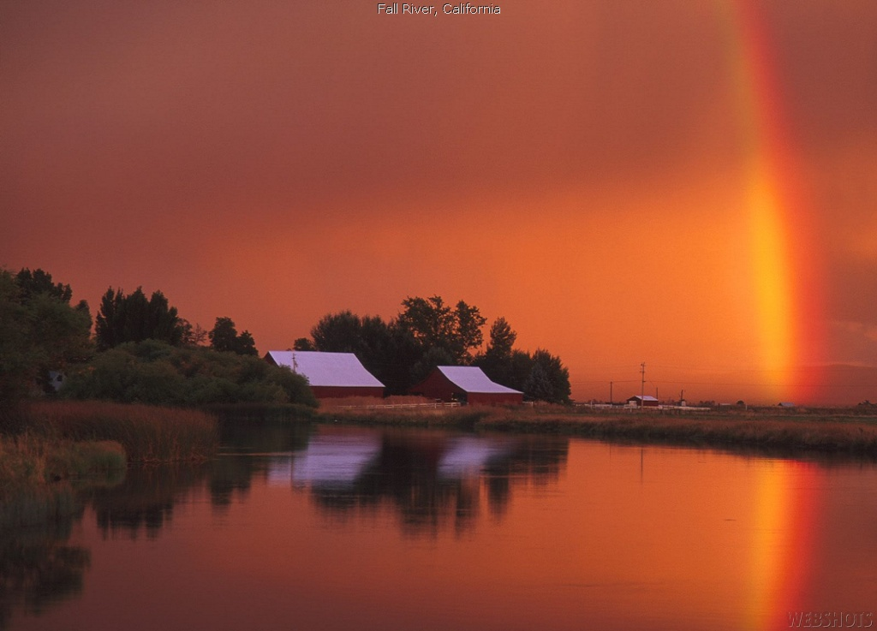
向萬邦傳福音
We’ve a story to tell the Nations
Hymns 463

Slide 2
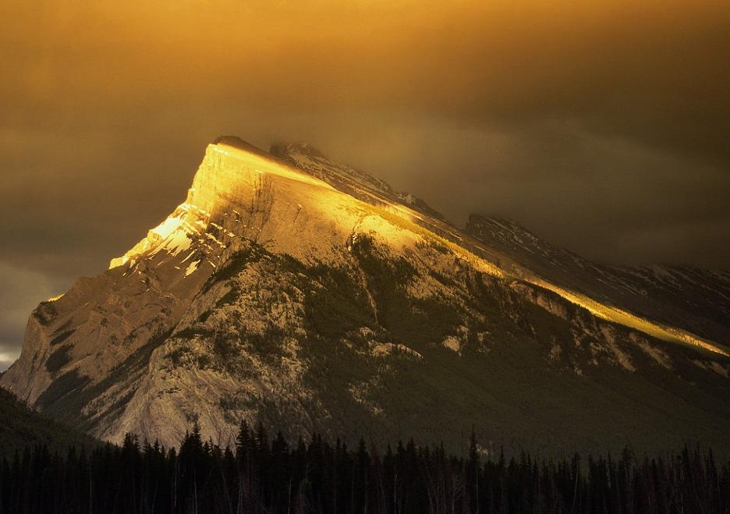
我們有一故事傳給萬邦，
使人心回轉免淪亡，
是真理與慈愛故事，
講述平安與真光，講述平安與真光。
We’ve a story to tell to the nations,
That shall turn their hearts to the right,
A story of truth and mercy,
A story of peace and light,
A story of peace and light.

Slide 3
因黑夜必要轉為晨光，
到午正更照耀輝煌，
基督國度必降臨地上，
全地充滿愛與光。
For the darkness shall turn to dawning,
And the dawning to noonday bright;
And Christ’s great kingdom shall come on earth,
The kingdom of love and light.

Slide 4
我們有一詩歌唱給萬邦，
要使人心向主歸降，
這詩歌能勝過罪惡，
能粉碎利劍矛槍，能粉碎利劍矛槍。
We’ve a song to be sung to the nations,
That shall lift their hearts to the Lord,
A song that shall conquer evil
And shatter the spear and sword,
And shatter the spear and sword.

Slide 5
因黑夜必要轉為晨光，
到午正更照耀輝煌，
基督國度必降臨地上，
全地充滿愛與光。
For the darkness shall turn to dawning,
And the dawning to noonday bright;
And Christ’s great kingdom shall come on earth,
The kingdom of love and light.

Slide 6
我們有一信息傳給萬邦，
主在高天掌權作王，
差遣愛子救贖我們，
顯明神慈愛無量，顯明神慈愛無量。
We’ve a message to give to the nations,
That the Lord who reigns up above
Has sent us His Son to save us,
And show us that God is love,
And show us that God is love.

Slide 7
因黑夜必要轉為晨光，
到午正更照耀輝煌，
基督國度必降臨地上，
全地充滿愛與光。
For the darkness shall turn to dawning,
And the dawning to noonday bright;
And Christ’s great kingdom shall come on earth,
The kingdom of love and light.

Slide 8
我們有一救主傳給萬邦，
祂曾經歷痛苦悽愴，
願全世界一切人民，
皆來向真理歸降，皆來向真理歸降。
We’ve a Savior to show to the nations,
Who the path of sorrow has trod,
That all of the world’s great peoples
Might come to the truth of God,
Might come to the truth of God.

Slide 9
因黑夜必要轉為晨光，
到午正更照耀輝煌，
基督國度必降臨地上，
全地充滿愛與光。
For the darkness shall turn to dawning,
And the dawning to noonday bright;
And Christ’s great kingdom shall come on earth,
The kingdom of love and light.

